Slide 1
SQL MINI Project
NAME: RAMU BHASHABOINA
BATCH: 2024 -11989
ENROLLMENT NUMBER: EBEON0624138983
COURSE: DATA ANALYTICS

Slide 2
Introduction to HR Database Schema Project
In the contemporary business landscape, effective human resource management is pivotal for organizational success. This HR database schema project is designed to develop a comprehensive database system to manage crucial HR functions and data, including employee details, departmental structures, geographical information, job history, and more. The goal is to create a robust and scalable schema that ensures efficient data management and retrieval, supports reporting, and enhances decision-making processes.

Slide 3
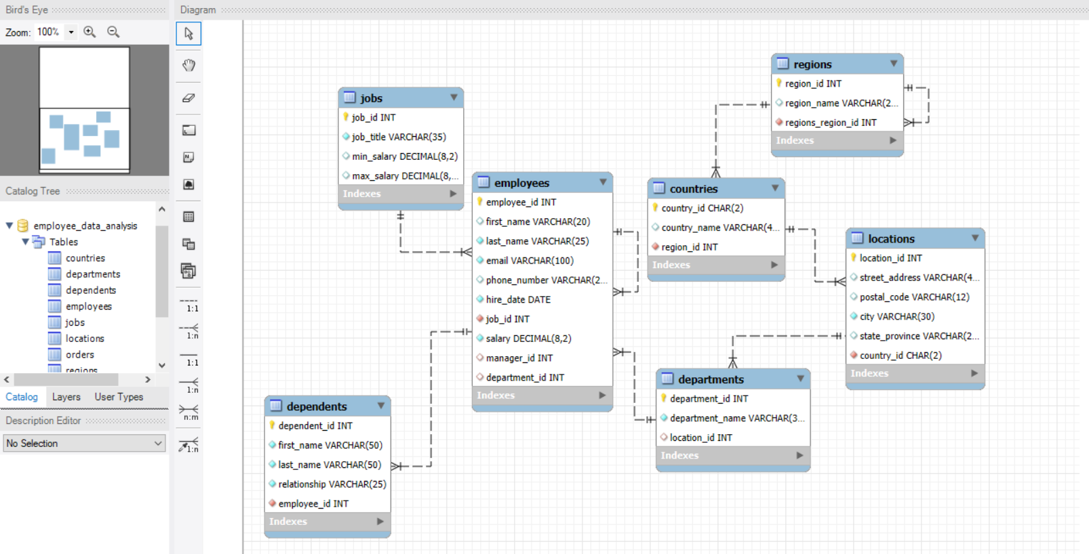
ER Diagram
4, 5, 6, 7, 8, 9, 10, 11, 12, 13, 14

Slide 4
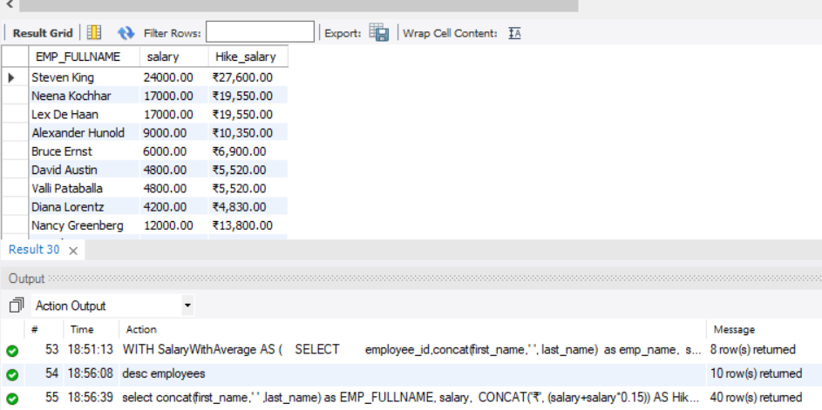
1). Give report on list the employees’ name, increased their salary by 15%, and expressed as number of rupees.
select concat(first_name,' ‘ , last_name) as EMP_FULLNAME, salary, CONCAT('₹', FORMAT((salary+salary*0.15), 2)) AS Hike_salary FROM employees;

Slide 5
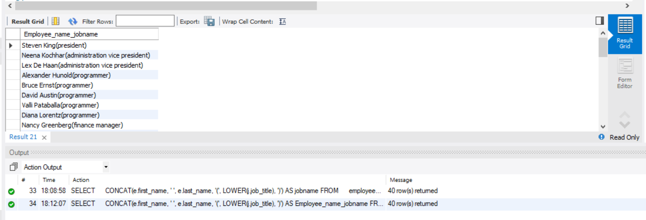
2) produce the output of employees as follows. Employee like employees_full_name(job_name) .
SELECT CONCAT(e.first_name, ' ', e.last_name, '(', LOWER(j.job_title), ')') AS jobname FROM employees e INNER JOIN jobs j ON e.job_id = j.job_id ORDER BY e.employee_id ASC;

Slide 6
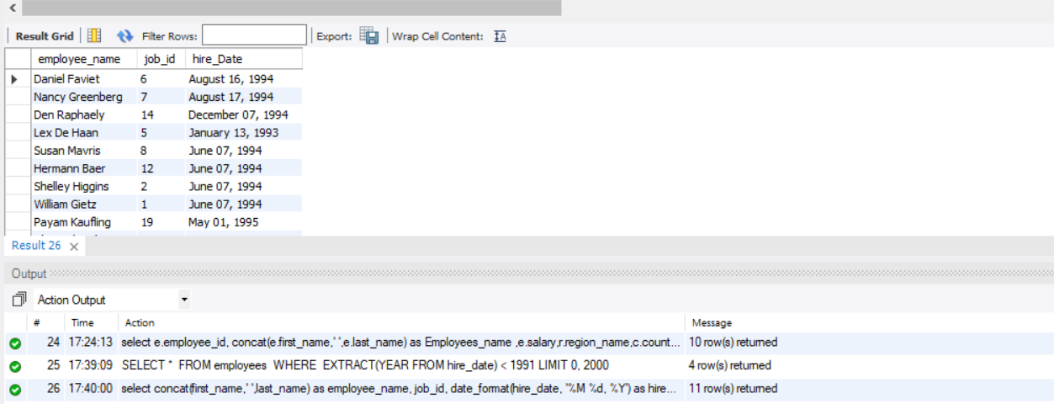
3) Give the report who all employees were hired between November 5th, 1990 and July 5th, 1995. Return full name (first and last), job id and hire date.
SELECT CONCAT(first_name,' ',last_name) as employee_name, job_id, hire_date FROM employees WHERE hire_date BETWEEN '1990-11-05' AND '1995-07-05' ORDER BY hire_date;

Slide 7
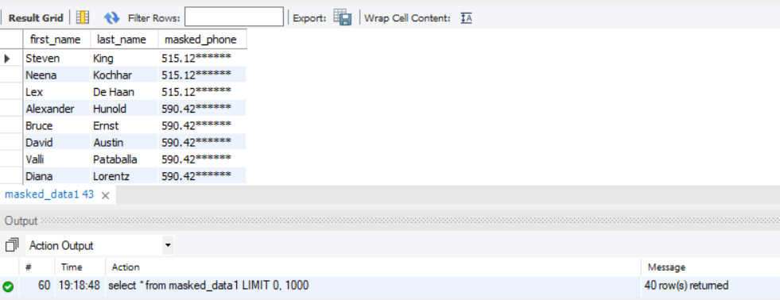
4) Give the report on employees table, the phone number in masked format of last 6 digits by create views from employees table
select * from employees;
CREATE OR REPLACE VIEW masked_data1 AS
SELECT first_name, last_name,
CONCAT(SUBSTRING(phone_number, 1, LENGTH(phone_number) - 6),REPEAT('*', 6) ) AS masked_phone FROM employees;
SELECT * FROM masked_data1;

Slide 8
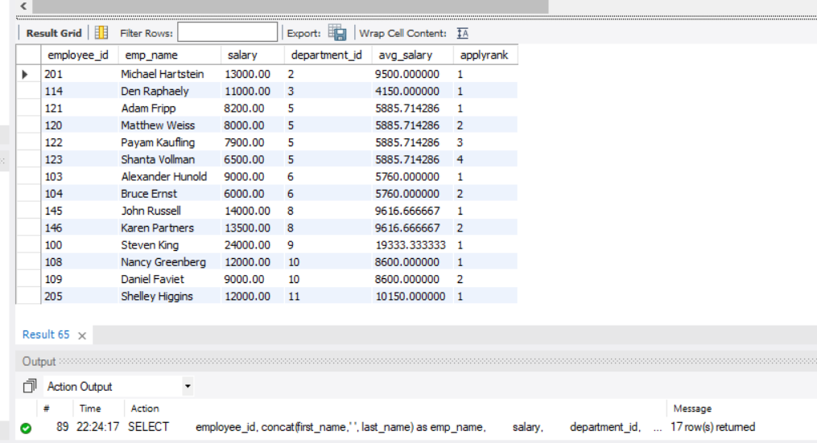
5) Give the report on who all are getting more than average salaray of all employees by department wise.
WITH SalaryWithAverage AS ( SELECT employee_id, concat(first_name,' ', last_name) as emp_name, salary, department_id, AVG(salary) OVER (PARTITION BY department_id) AS avg_salary, RANK() OVER (PARTITION BY department_id ORDER BY salary DESC) AS applyrank FROM employees)
SELECT *FROM SalaryWithAverageWHERE Salary > avg_salary;

Slide 9
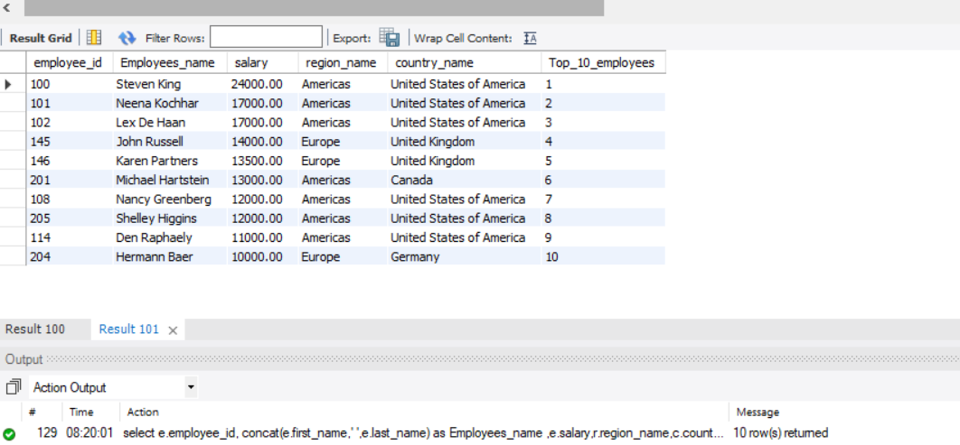
6) Generate report who all are getting highest salary from employees more than average salary of all employees in top 10 and find their region and country.
select e.employee_id, concat(e.first_name,' ',e.last_name) as Employees_name,e.salary, r.region_name, c.country_name, row_number() over (order by e.salary desc) as Top_10_employees from employees e join departments d on e.department_id = d.department_id join locations l on l.location_id=d.location_id join countries c on c.country_id = l.country_id join regions r on r.region_id = c.region_id where salary > (select avg(salary) from employees) limit 10;

Slide 10
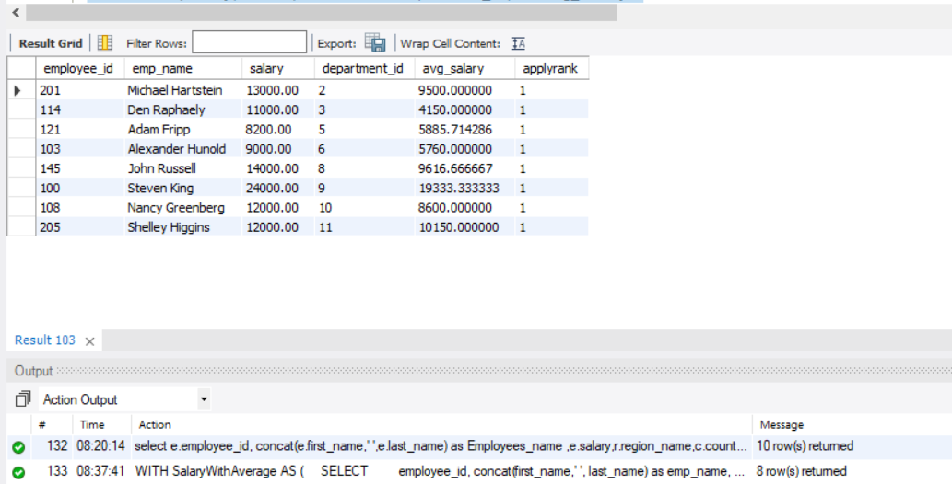
7) find the average salary by department wise and who are getting max salary more than avg salary of employees department level, first position by department wise.
WITH SalaryWithAverage AS ( SELECT employee_id, concat(first_name,' ', last_name) as emp_name, salary, department_id, AVG(salary) OVER (PARTITION BY department_id) AS avg_salary, RANK() OVER (PARTITION BY department_id ORDER BY salary DESC) AS applyrank FROM employees)
SELECT *FROM SalaryWithAverageWHERE Salary > avg_salary and applyrank=1 ;

Slide 11
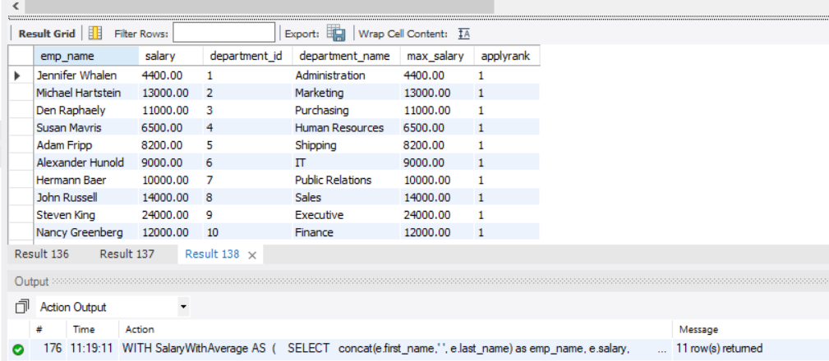
8) find the employees names, and departments names who all employees are in top1 position by department wise.
WITH SalaryWithMax AS ( SELECT concat(e.first_name,' ', e.last_name) as emp_name, e.salary, d.department_id, d.department_name , max(salary) OVER (order by e.salary) AS max_salary, RANK() OVER (PARTITION BY d.department_id ORDER BY salary DESC) AS applyrank FROM employees e join departments d on e.department_id = d.department_id)
SELECT *FROM SalaryWithAverage WHERE applyrank=1 ;

Slide 12
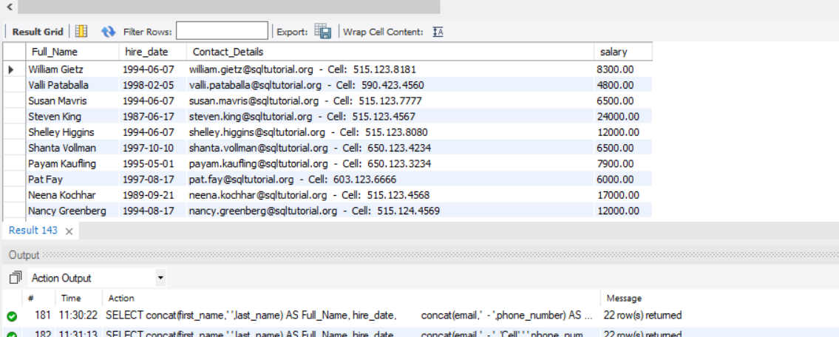
Give the report of employees who earns above 11000 or the seventh character in their phone number is 3. Sort the result-set in descending order by first name. Return full name (first name and last name), hire date, email, and telephone separated by '-', and salary.
SELECT concat(first_name,' ',last_name) AS Full_Name, hire_date, concat(email,' - ', 'Cell: ',' ',phone_number) AS Contact_Details, salary FROM employees WHERE salary > 11000 OR phone_number LIKE '______3%' ORDER BY first_name DESC;

Slide 13
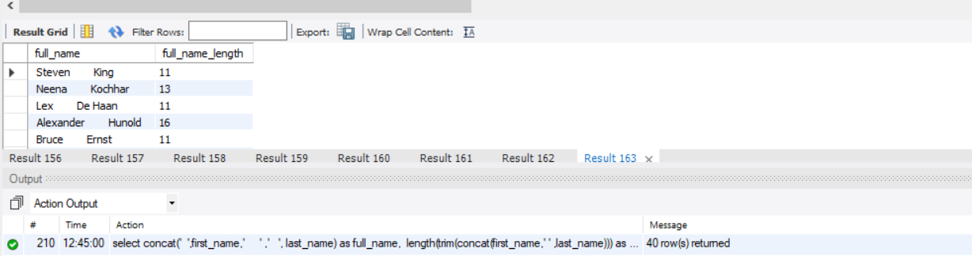
10) Give a report to count the number of characters except the spaces for each employee name. Return employee name length.
select concat(' ',first_name,' ' ,' ', last_name) as full_name, length(trim(concat(first_name,' ' ,last_name))) as full_name_length from employees;

Slide 14
CONCLUSION
This HR database schema project represents a significant advancement in the way HR data is managed and utilized within the organization. By developing a structured and integrated schema, the project aims to enhance HR operations, support informed decision-making, and contribute to the overall effectiveness of the HR function.
THANK YOU

